Slide 1
PORTALIX- Productivity Dashboard
Full-stack Streamlit application with AI features powered by Google Gemini Flash
CAPSTONE PROJECT
Presented By:
Student Name- Asish Kumar Sahoo
College Name- Stewart Science College
Department- BSc(Hons). Zoology
4. AICTE ID- STU689234386777b1754412088

Slide 2
OUTLINE
Problem Statement
Proposed Solution
System Development Approach
Algorithm & Deployment
Result
Conclusion
Future Scope
References
Deployment Link

Slide 3
Problem Statement
Modern digital workflows require juggling multiple browser tabs, web tools, scattered notes, and credentials daily.
Excessive tab clutter leads to cognitive overload, reduced focus, and lost browsing context.
Existing productivity tools lack unified security: passwords are often stored insecurely in plain text or browser auto-fills without localized encryption.
Traditional reminder apps lack semantic understanding and require rigid date/time pickers rather than natural-language phrasing.
Users have little visibility into how their screen time is distributed across sites without manual logging tools.

Slide 4
Proposed Solution
Unified Dashboard OS: A single-pane Streamlit web interface acting as an operating hub for daily browsing, workspaces, and productivity tracking.
Pinned Websites Hub: Centralized bookmarking with automated AI classification and concise website summaries using Google Gemini Flash.
Themed Custom Spaces: Logical groupings of resources (e.g., Work, Dev, Media) to open and manage workspaces systematically.
Encrypted Password Vault: Client-side Fernet symmetric AES encryption ensuring credentials are never stored in plain text.
Smart Reminders: Natural Language Processing (NLP) integration via Gemini to parse freeform text (e.g., "Review goals tomorrow at 9 AM") into machine-readable dates.
Analytics Engine: Visual time-tracking and hourly heatmaps paired with automated AI productivity insights.

Slide 5
System Approach
Frontend / Framework: Streamlit (Python-native reactive UI, glassmorphic CSS styling, and dynamic themes)
Backend Language: Python (Python 3.10+)
Data Processing & Visualization:
  pandas (session data aggregation, datetime filtering)
  plotly.express and plotly.graph_objects (donut charts, usage bar graphs, activity heatmaps)
Security & Cryptography:
  cryptography.fernet (Symmetric AES-128 in CBC mode with HMAC SHA256)
  hashlib (SHA-256 password hashing for authentication)
AI & Language Model:
Google Gemini API (google-genai SDK: gemini-2.5-flash / gemini-3.5-flash-lite)
Configuration: python-dotenv for secure environment variable isolation

Slide 6
Algorithm & Deployment
Algorithm Selection:
  Fernet Symmetric Cryptography (AES-128-CBC + HMAC-SHA256): Selected to secure stored credentials in the password vault, guaranteeing that sensitive keys and passwords remain unreadable even if application state is inspected.
  Google Gemini Large Language Model (Flash Series via Zero-Shot Prompting): Utilized for semantic understanding, contextual natural language time parsing, and automated URL content summarization.
Data Input:
  Vault Input: Plaintext user strings, target service names, and master derivation seeds.
  AI Inputs: Unstructured human reminder phrasing (e.g., "Finish report tomorrow at 3 PM"), target website URLs, and aggregated 30-day browsing telemetry.
Processing & Inference Pipeline:
  Encryption Pipeline: Plaintext credentials pass through Fernet URL-safe Base64 encoding and HMAC integrity verification prior to memory storage.
  Resilient Multi-Model LLM Routing: Prompts cycle dynamically through gemini-2.5-flash, gemini-3.5-flash-lite, and gemini-3.1-flash-lite with backoff retries to prevent downtime from API rate limits (HTTP 429) or high-demand server spikes (HTTP 503).
Deployment Process:
  Continuous Integration & Delivery (CI/CD): Version-controlled code hosted on GitHub triggers automated builds upon every commit.
  Cloud Hosting: Deployed on Streamlit Community Cloud with environment secrets (GEMINI_API_KEY, ENCRYPTION_KEY) securely injected at runtime for global accessibility.

Slide 7
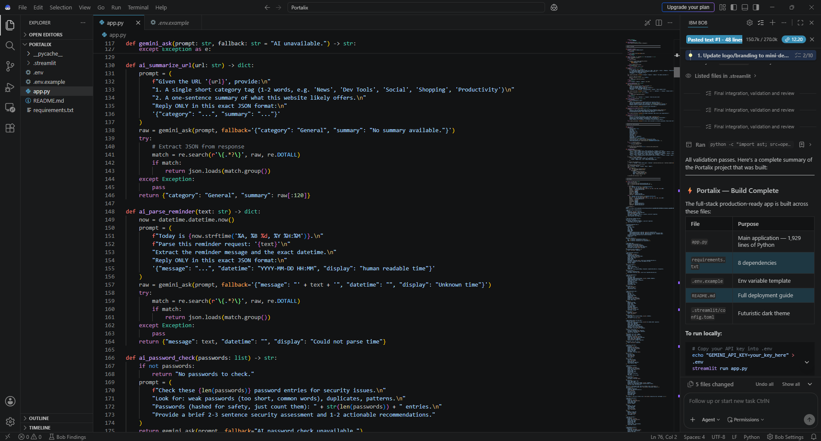
Result

Slide 8
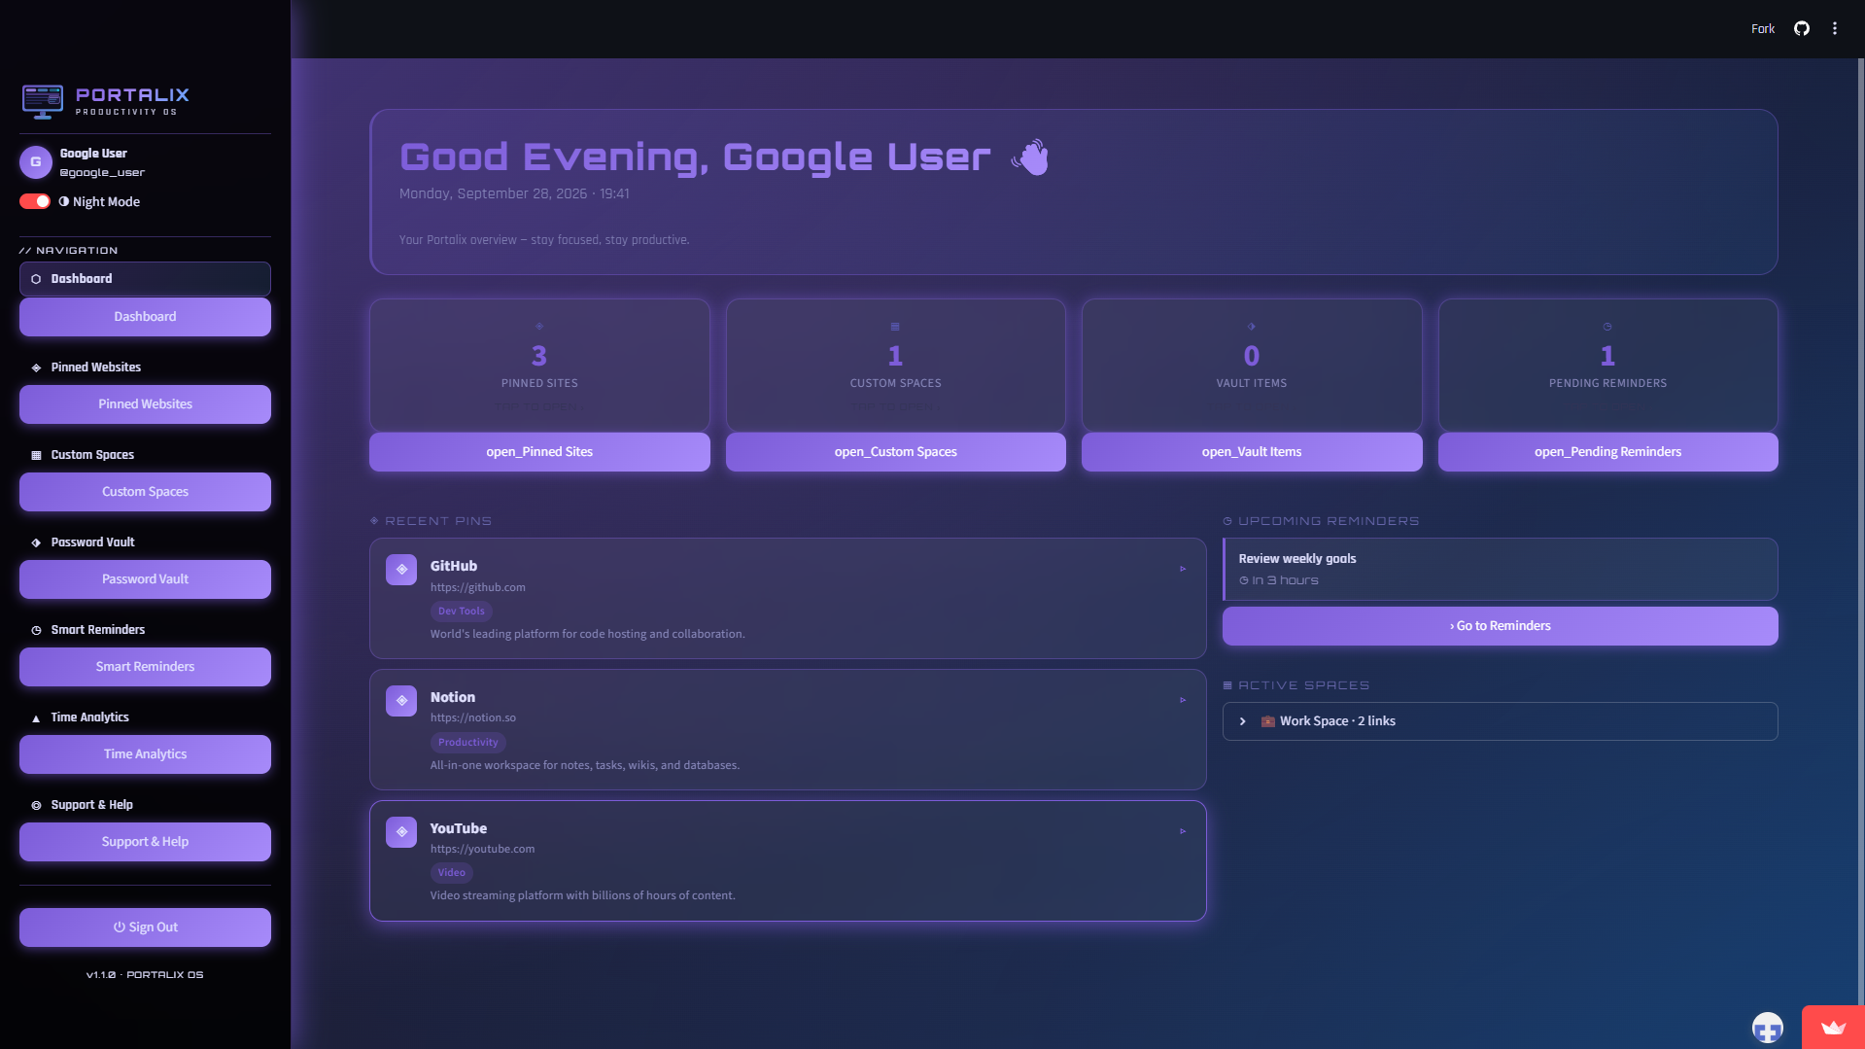
RESULT

Slide 9
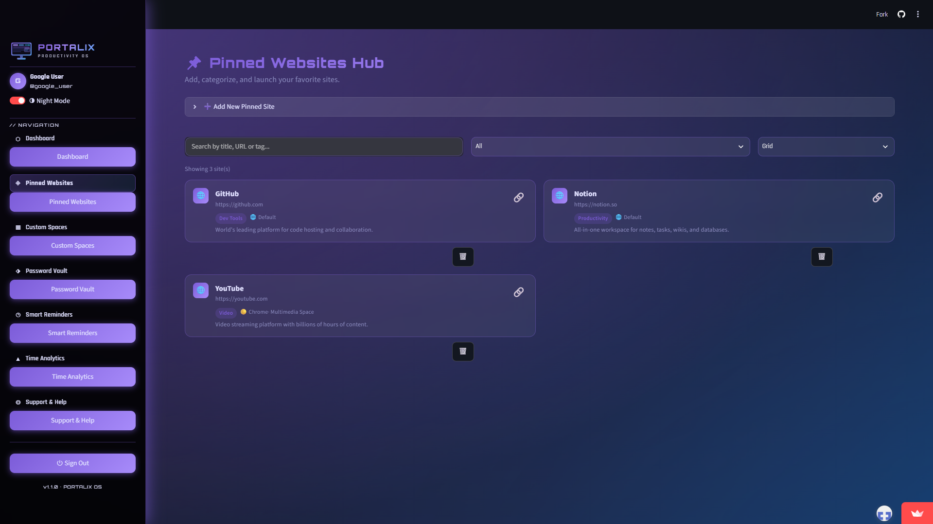
result

Slide 10
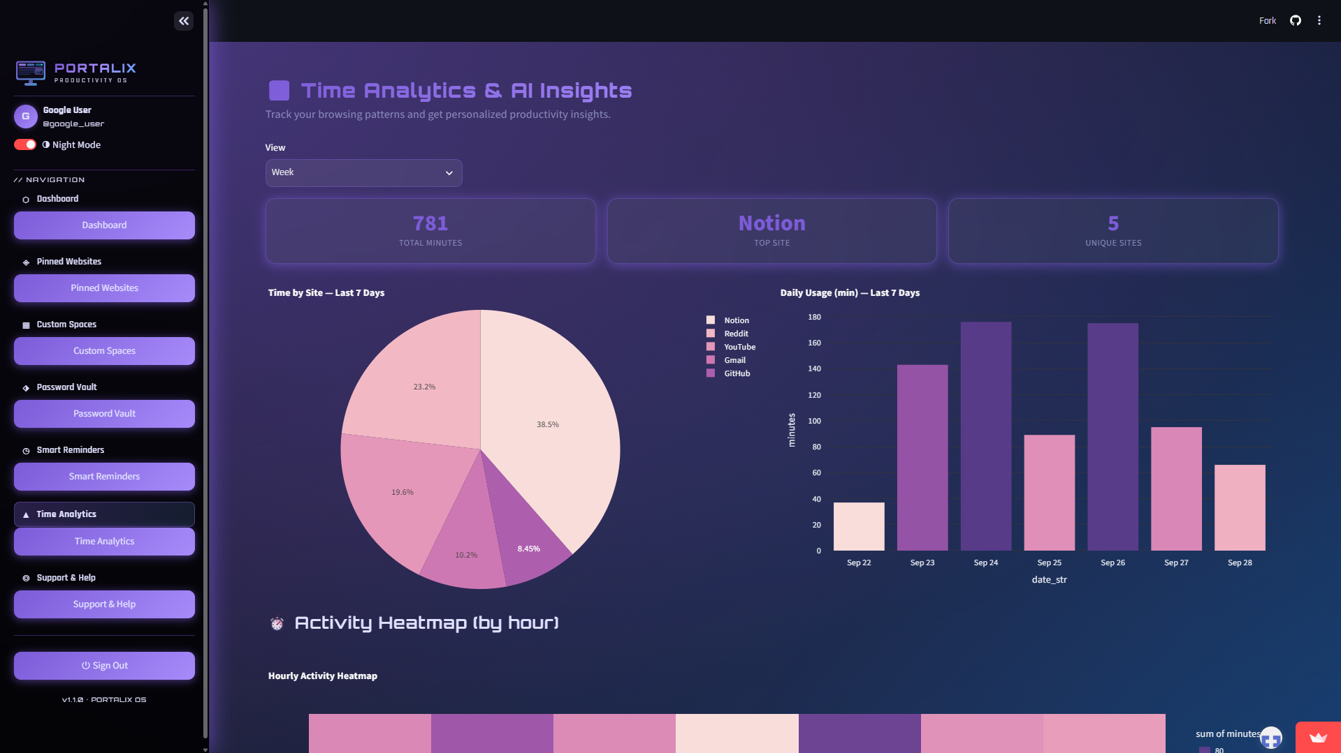
result

Slide 11
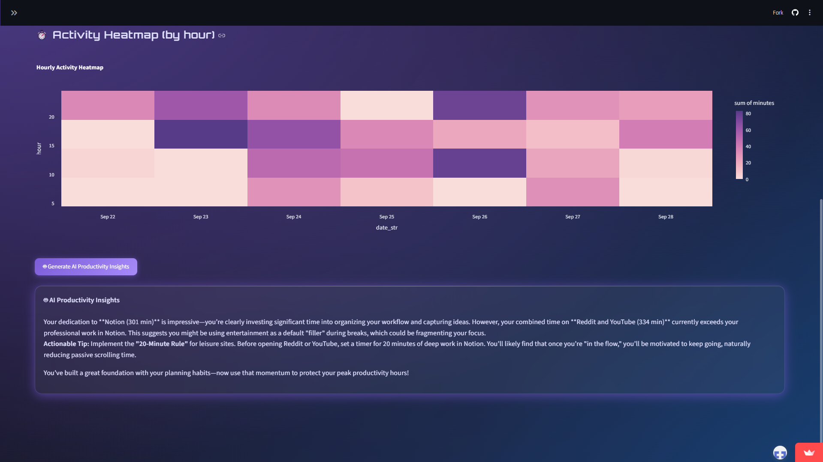
RESULT

Slide 12
Conclusion
Developed a fully responsive, full-stack productivity web app using pure Python and Streamlit.
Successfully eliminated tab distraction by unifying bookmarks, workspace suites, credentials, and natural-language tasks into one application.
Integrated cloud AI capabilities with fallback protection to maintain uptime on free-tier limits.
Maintained data privacy through client-side cryptographic hashing and Fernet encryption.

Slide 13
Future scope
Cloud Database Persistence: Replace temporary st.session_state storage with persistent cloud databases like Supabase, Firebase, or PostgreSQL.
Browser Extension Sync: Build a lightweight Chrome/Firefox browser extension to auto-sync active browser tabs and browsing history directly into Portalix spaces.
OAuth 2.0 Integration: Implement live multi-tenant authentication using Google, GitHub, or Auth0 OAuth providers.
Task Automation: Integrate webhooks and calendar synchronizations (Google Calendar, Outlook) for smart reminders

Slide 14
References
Streamlit Documentation:
  https://docs.streamlit.io
Google Gemini API Documentation:
  https://ai.google.dev/docs
Cryptography (Fernet) Docs:
  https://cryptography.io/en/latest/fernet/

Slide 15
Deployment link / github link
Github Repository :-
  https://github.com/asishkumarsahoo614/Portalix.git
Live Streamlit Application :-
  https://p0rtalix-demo.streamlit.app/

Slide 16
THANK YOU

